Slide 1
CS 1050 "CS1"
Blanche Cohen
blanche@acm.org
www.nyx.net/~bcohen/CS1
Office Hours:
Tuesday & Thursday after class
Always by appointment
3rd Floor Science – Part-timer Offices

Slide 2
Metro Policies
Calendar – Drop, Withdraw, Incomplete, Holidays
100% refund: Thursday, May 25
50% refund: Thursday, June 1
Last Day for W*: Friday, July 7
https://mcs.msudenver.edu/policies

Slide 3
Rules of Engagement
Everyone is an adult and is treated as such
I teach this course as if in a professional environment
Please be considerate of your classmates
Emily Post & Miss Manners have the right idea
Turn your cell phones to silent
If you bring breakfast, please avoid an overabundance of garlic, onions or other strong aromas

Slide 4
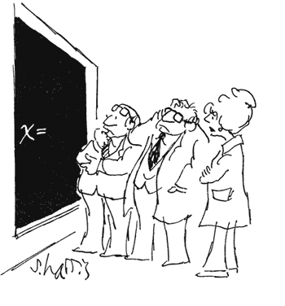
How to Succeed… (but you do have to try)
Be an active learner
Ask questions in class (you’re not the only one who doesn’t understand, really)
Go to instructor’s office
hours or make an
appointment

Slide 5
How to Study
Avoid cramming
Stay current on reading and homework
Practice solving as many different problems as you can.
Don't get behind
Make a one-page summary sheet of the key terms, ideas, formulas, etc., that you might need to know on the test.

Slide 6
Grading
Homework: 60%
Exams:
Midterm 20%
Final 20%
A: 90-100%
B: 80-89%
C: 70-79%
D: 60-69%
Note: You must pass both homework & exams to pass the course.

Slide 7
The Approach
Understand the problem
Create the solution
Choose how to implement the solution
in this course, we implement using Java
Emphasis on following chapters (not necessarily in this order)
1 and App A & B
2,3,4 & App C & D
7, 8, 9, 10, 14

Slide 8
Tools
Programming is a Science and an Art
The best analytical tool is your brain
Paper & Pencil
Writing code is the LAST action!
Software allows you to generate (very fast) huge quantities of garbage that looks really impressive.
There are no shortcuts – the best way is to learn by doing

Slide 9
Inside a Computer
Memory – direct connection to the CPU
Disk drive (spins, thumb drive, floppy disk, SSD, internal, external, network, many others)
Programs run in memory, are stored on Disk
Take CS 1400 for more gory details

Slide 10
Objects
Objects – User defined complex data types
An object has structure or state (variables) and methods (behavior/operations)
An object is described by four characteristics
Identifier: a system-wide unique id for an object
Name: an object may also have a unique name (optional)
Lifetime: determines if the object is persistent or transient
Structure: Construction of objects using type constructors

Slide 11
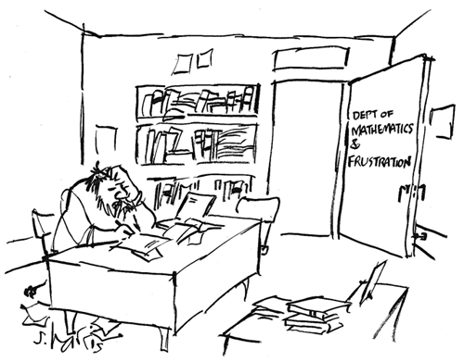
Mindset Matters

